Slide 1

HANDS-ON WITH REACT

Slide 2
Conditional
rendering
We often need change how a component is displayed depending on certain conditions.

Slide 3
To conditionally render information is one of the staples of being able to keep a website up to date.
We have no idea when data may change, but when it does, we need our creations to immediately reflect the change
How to conditionally render content
Notes:
We will go back to the props content from the last chapter and continue on with our Cards and employees

Slide 4
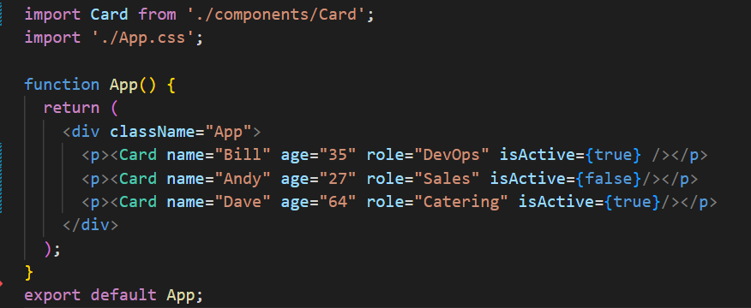
We need to add a new parameter to the list of props accepted by the Card component.
isActive will be a Boolean value that we can then add or remove content to the webpage
We also need to include it in the Card call in App.js
How to conditionally render content

Slide 5
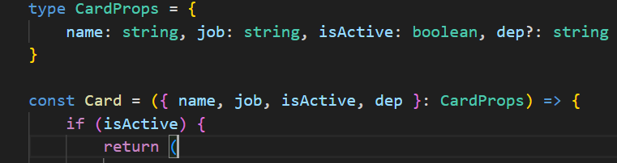
We need to add a new parameter to the list of props accepted by the Card component.
isActive will be a Boolean value that we can then add or remove content to the webpage
We also need to include it in the Card call in App.tsx
How to conditionally render content
Notes:
Custom type on one line for ease of screenshotting

Slide 6
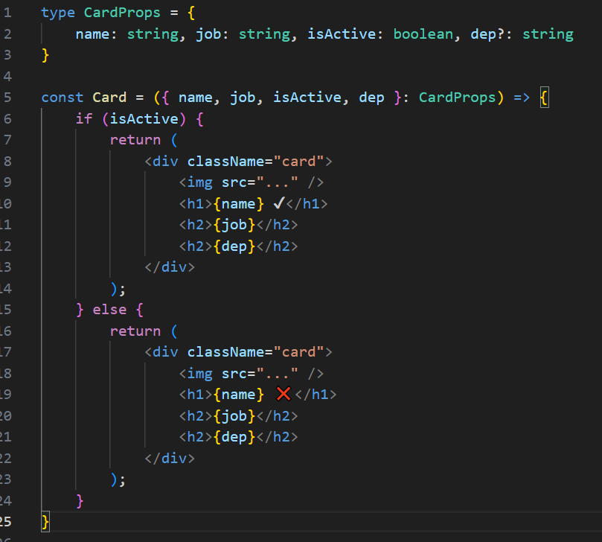
How to conditionally render content
This can be done multiple ways
1) Render entire card based on Active Status
Notes:
This is possible but not recommended due to the repeating code

Slide 7
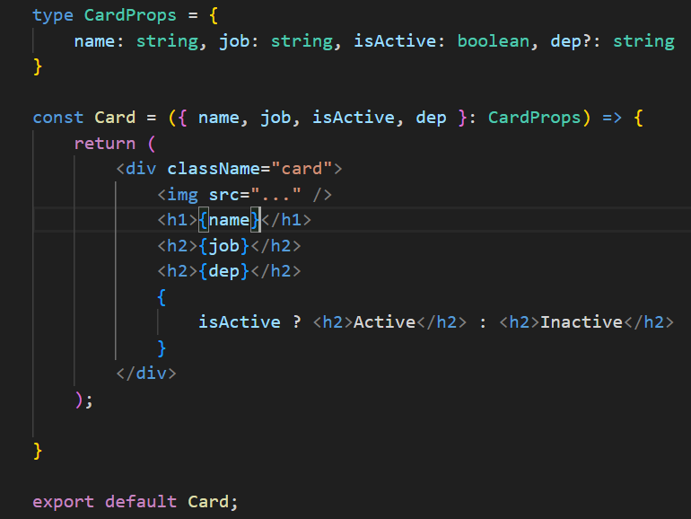
How to conditionally render content
This can be done multiple ways:
1) Ternary operator
Notes:
This is possible but not recommended due to the repeating code

Slide 8
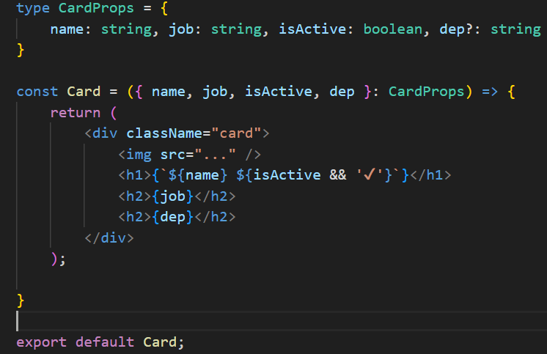
How to conditionally render content
This can be done multiple ways
1) Ternary operator, Logical && Operator
Notes:
Single line of code.
In JavaScript:
- true && <value> evaluates to <value>
- false && <value> evaluates to false
So, if the condition is true, then React will display whatever comes after the &&.
And, if the condition is false, the whole expression evaluates to false. When React sees a false value, it renders nothing.

Slide 9
QuickLab 4
Conditional Rendering

Slide 10
Rendering
lists
Displaying many similar components from a collection of data is something that happens all the time.
Let’s look at how to transform an array of data into an array of components.

Slide 11
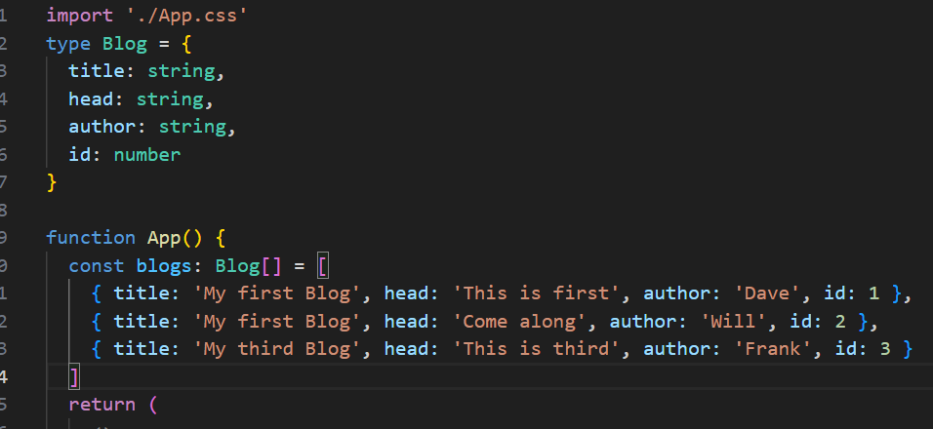
There is an array of data dropped into the App.tsx file. This is JSON data that you learned about earlier in this section.
Can use JS map() tools to take this information from the const called blogs and output it onto a page
Rendering
lists

Slide 12
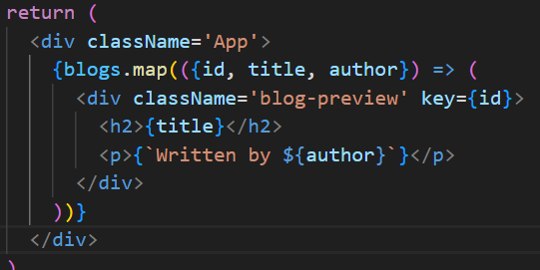
The return takes the blogs and passes them as a callback function. This allows us to simply deconstruct the array
Notice the dot(.) notation. This is taking each blog from blogs and doing the same thing to it.
Just like for OR foreach
Rendering
lists
Notes:
Important to point out that the key MUST be unique for the map to work, hence why we have included it in the array

Slide 13

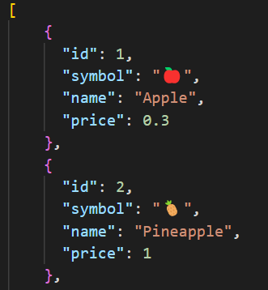
However, it is likely that you will be collecting data from external sources such as APIs, Databases etc and it is important to understand how to go about doing this in react.
A file has been created with some data relating to some fruit.
Rendering
lists
Notes:
[
{
"id": 1,
"symbol": "🍎",
"name": "Apple",
"price": 0.3
},
{
"id": 2,
"symbol": "🍍",
"name": "Pineapple",
"price": 1
},
{
"id": 3,
"symbol": "🍉",
"name": "Watermelon",
"price": 4
},
{
"id": 4,
"symbol": "🥝",
"name": "Kiwi",
"price": 0.5
},
{
"id": 5,
"symbol": "🍊",
"name": "Orange",
"price": 0.3
},
{
"id": 6,
"symbol": "🍋",
"name": "Lemon",
"price": 0.2
}
]

Slide 14
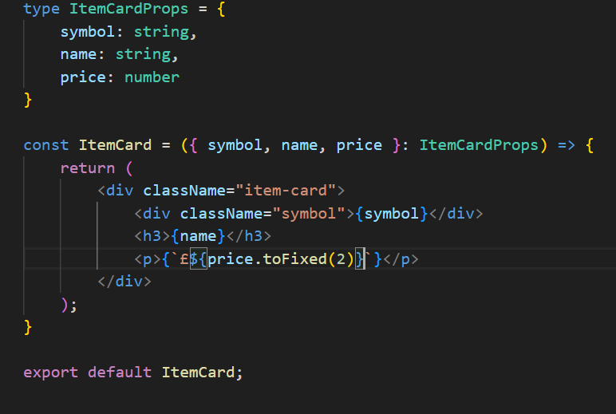
Like before, I will create a card that will help with styling the components and put it in a separate JSX file
This card has been set up to accept the content of the JSON file and will be passed the data as props from App.js
Rendering
lists
Notes:
[
{
"id": 1,
"symbol": "🍎",
"name": "Apple",
"price": 0.3
},
{
"id": 2,
"symbol": "🍍",
"name": "Pineapple",
"price": 1
},
{
"id": 3,
"symbol": "🍉",
"name": "Watermelon",
"price": 4
},
{
"id": 4,
"symbol": "🥝",
"name": "Kiwi",
"price": 0.5
},
{
"id": 5,
"symbol": "🍊",
"name": "Orange",
"price": 0.3
},
{
"id": 6,
"symbol": "🍋",
"name": "Lemon",
"price": 0.2
}
]

Slide 15

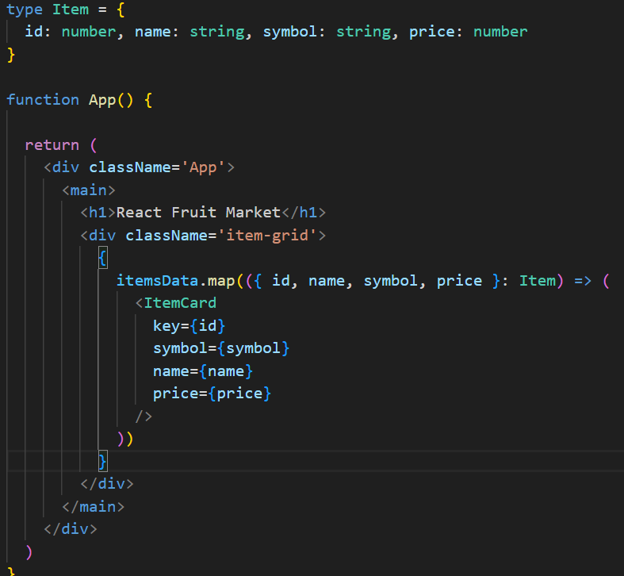
Firstly, we need to import the data to react from the JSON file.
This takes the entire JSON file and drops it into a variable called itemsData. It can then be mapped through
Rendering
lists

Slide 16
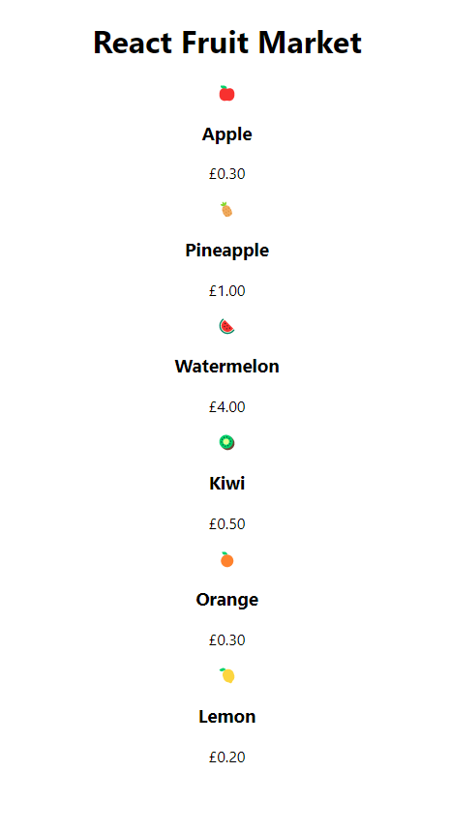
So the data is in there nicely, but we need to apply some stylings to ensure that our website looks the part
Rendering
lists

Slide 17
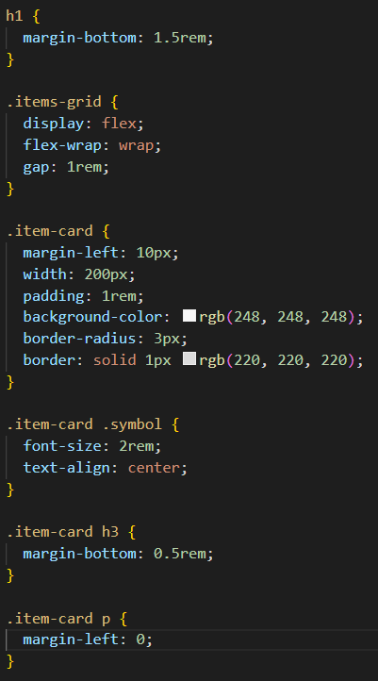
App.css Stylings will turn these into cards, similar to bootstrap and other library styles
Rendering
lists

Slide 18
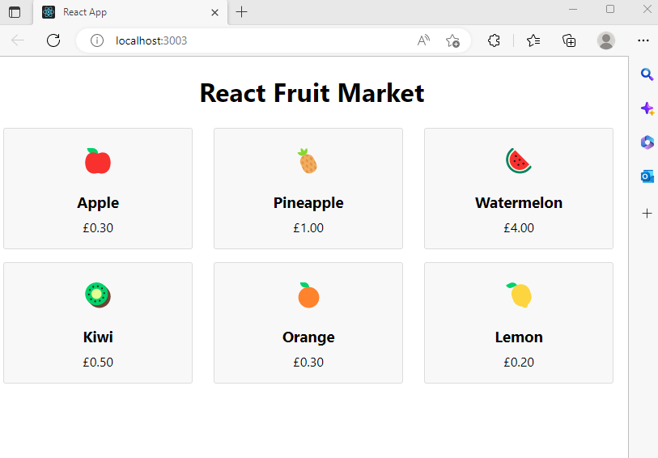
This results in data being pulled from a file and rendered on our webpage
Rendering
lists

Slide 19
QuickLab 5
Rendering External Data

Slide 20
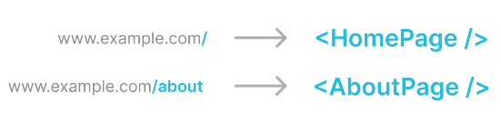
Most websites have different routes.
React Router provides lots of useful routing-related features, including a simple way to display different content depending on which route is currently active.
React
Router
This facilitates the creation of single-page applications.

Slide 21
So, what is a single-page application?
Contrary to what the name suggests, a single-page app (or SPA) is not just a website where all the content is contained on one long page.
Let’s look at the difference between a traditional multi-page site and a single-page application.
Single-Page
APPS

Slide 22
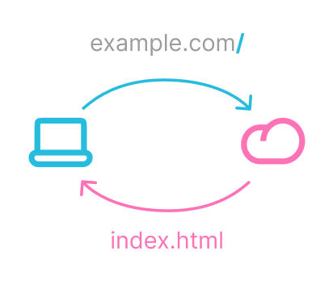
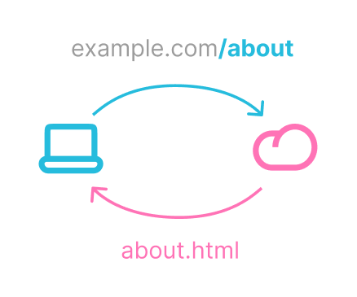
Traditional (multi-page) website
Notes:
Here is an oversimplified explanation of how a traditional multi-page website would handle different pages, or “routes”.
On the left side, we have the client. This is the user’s computer.
On the right side, we have the server. This is another computer hosted somewhere else that contains all of the website’s files, and can send those files to the client.
(Top image) When the client visits “example.com”, that sends a request to the server, which processes the request and sends back an HTML file. The user’s browser will then process and display the content of the HTML file on the user’s screen.
(Bottom image) Then, if the user later navigates to the “about” page, the server processes the new request and responds with the “about.html” file. This “About” page replaces the page that was previously displayed on the user’s browser.

Slide 23
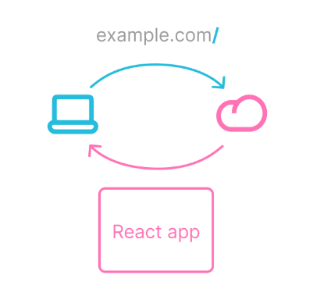
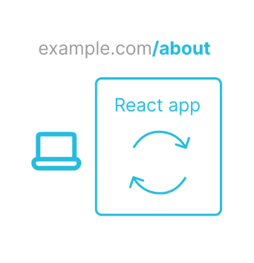
Single-page
application
Notes:
Now, in a single-page React application, things work a little differently.
(Top image) When the client makes a request to example.com, in a single-page application setup the server will respond by sending an entire React app, which will then be loaded by the user’s browser.
(Bottom image) Then, when the user navigates to the “/about” page, the client doesn’t actually make another request to the server at all. In a single-page application, the navigation happens on the user’s device – in other words, on the “client side”. The React app will simply switch which content is rendered on the page.
Unlike in a multi-page application, we don’t need to wait for a response from the server, so the transition between pages will be immediate. This is one of the advantages of single-page applications – they allow for a faster and smoother experience for the user (at least once the app has been loaded).

Slide 24
Now that we’ve covered the concept of client-side routing, let’s see it in practice.
For Routing to work in react, You need to run some npm installs first
And
These allow up to set up pages for routing in SPA set up just discussed
React
Router
npm install react-router
npm install react-router-dom

Slide 25
It is good practice to set up a nav bar component which will appear on each of our pages. This can be done in the usual way.
On thing that will change is that we will need to import { Link } from the react-router-dom to tell react that we want to render different pages to the app.
When we then use the <Link> tag, we specify where we want the link to take us to. For example, “/” is the home page and “/about” would be https://127.0.0.1/about
React
Router

Slide 26
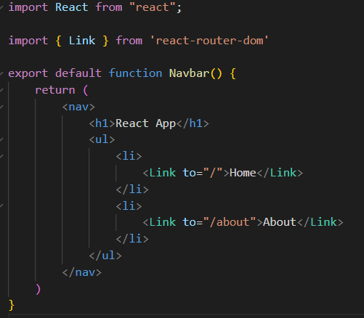
This gives us 2 links with predefined destinations
React
Router
Notes:
We can now take this component and use it in the App.js page so it appears throughout our App

Slide 27

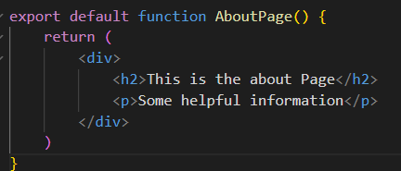
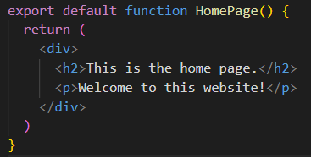
We can render 2 simple components for testing
React
Router

Slide 28
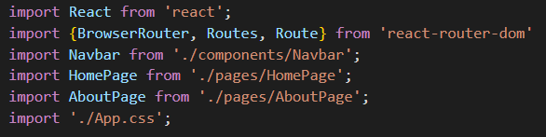
We set up App.js to import the required components for routing to take place
React
Router

Slide 29
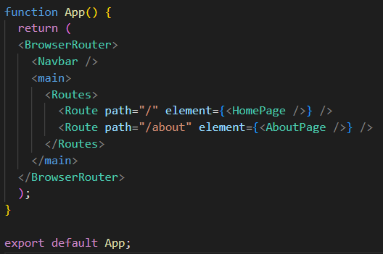
Finally, we build the structure and tell react which components to render when which link is clicked
React
Router

Slide 30
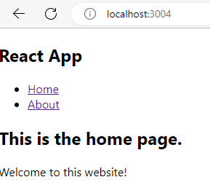
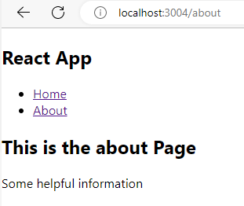
Finally, we build the structure and tell react which components to render when which link is clicked
React
Router

Slide 31
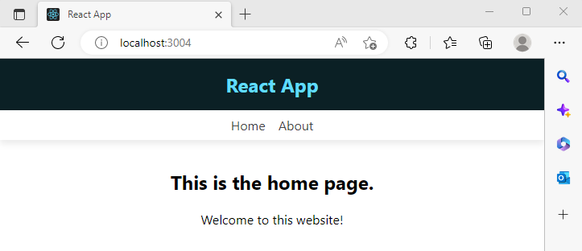
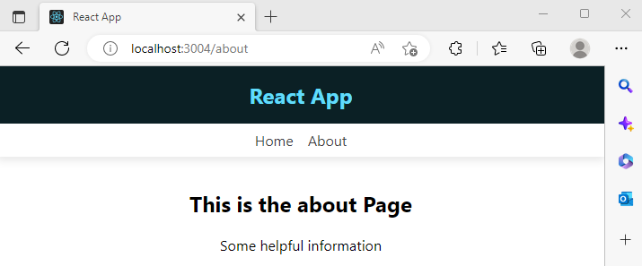
After some styling with CSS, the final output is
React
Router

Slide 32
QuickLab 6
Creating Routes

Slide 33
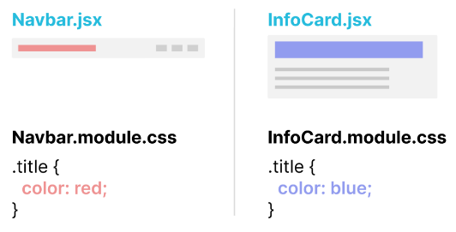
As you add more and more components to your project, it becomes unwieldy to store your CSS in a single file.
CSS Modules provide one solution that allows you to create component-scoped styles.
Bonus: CSS
Modules
React-6 | See examples and exercises

Slide 34
HANDS-ON PROJECT
At your own pace, work through
Challenge 1

